Slide 1


ECEN 404 Final Presentation Team 42: Multi-Axis Cobot for Factory Automation Emily Hamsa, Ethan Woods, Adrian Guzman, Jaishil Shah
Sponsor: Will Hofstetter
TA: Vishwam Raval

Slide 2


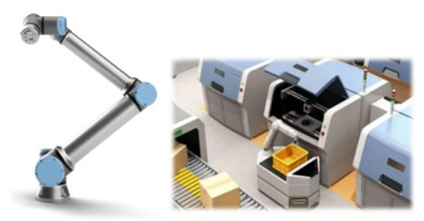
Project Summary
Problem statement:
Factory settings pose dangerous environments to human workers through the exposure to heavy machinery, tight spaces, and repetitive workloads. These hazards increase chance of injury and worker burnout. We need to implement collaborative robots (Cobots) to improve worker conditions.
Human Injury & Burnout in Warehouses
Cobot Solution
Notes:
Adrian

Slide 3
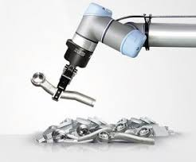
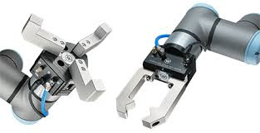
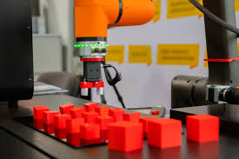
Project Summary
Solution proposal:
Develop a Cobot that can integrate into a factory environment to reduce human injury, worker burnout, and increase productivity in repetitive tasks. The Cobot shall be able to lift (1 lb) and be placed into tight environments and controlled wirelessly through mobile app.
Repetitive Tasks
1 lb Load
Precise Control
Notes:
Ethan

Slide 4
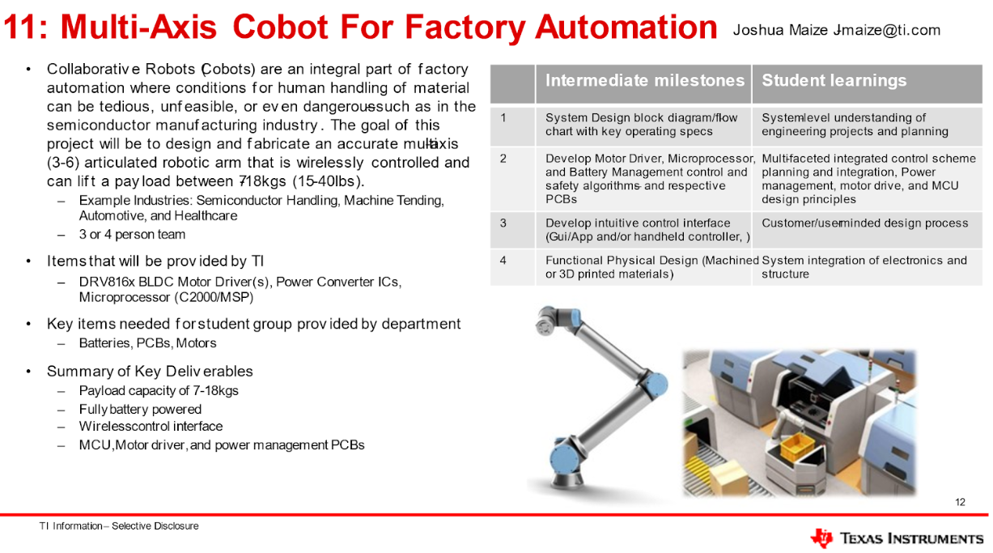

Slide 5
Project Scope Changes
Throughout the semester, we recognized that adjustments to our project scope were necessary. After discussion with our sponsors and professors, we revised the scope to better manage time and resources–shifting focus toward electrical hardware design and testing rather than mechanical fabrication.
Reduced payload capacity from 7-18kgs (15-40 lbs) to 1 lb
15-40 lbs. was unrealistic given our budget constraints
Purchased a cobot frame from Amazon
Minimized mechanical design time and complexity
Decreased BLDC motor count to 1 and used servo motors for arm movement
1 BLDC motor to demonstrate motor driver functionality
4 servos to validate the robotic arm concept

Slide 6
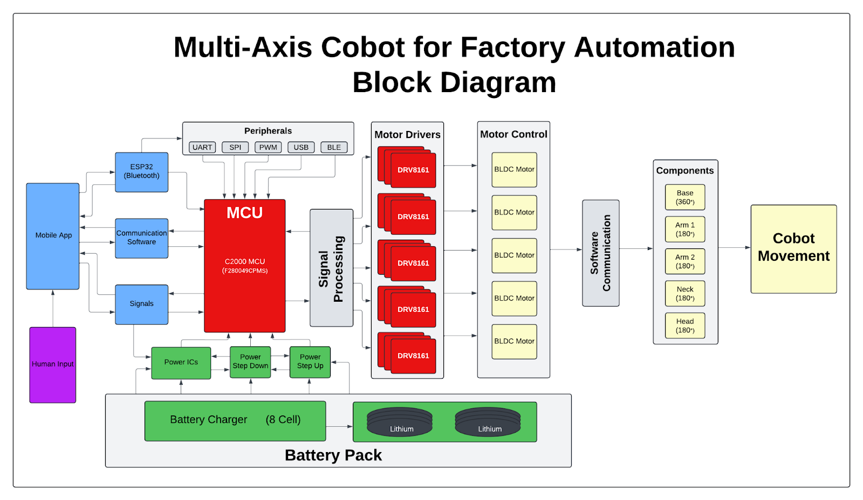
Project/Subsystem Overview
Adrian
Ethan
Jaishil
Emily
Subsystem Diagram Color: Power, MCU/Connectivity, Mobile App, Motor Control

Slide 7
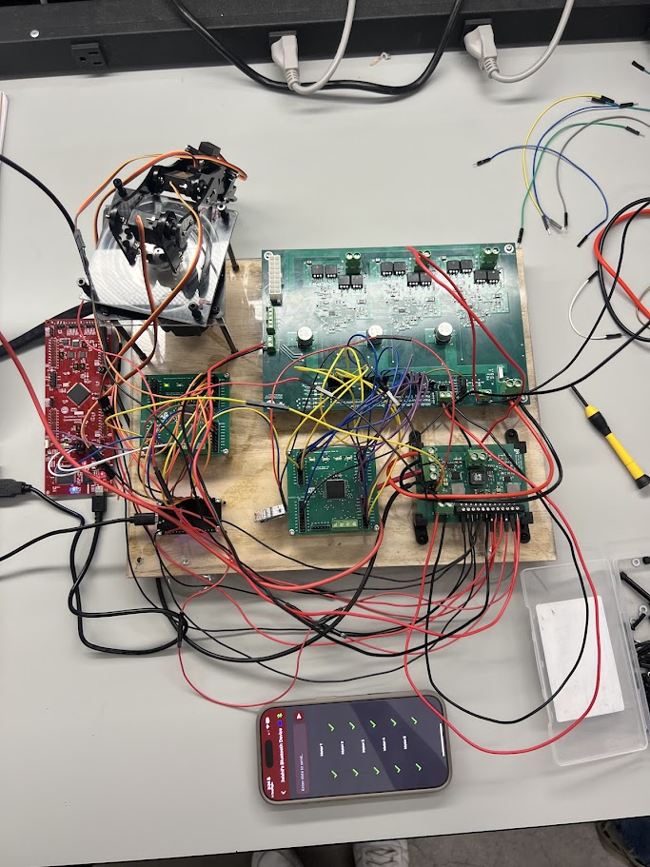
Integrated System Diagram
Cobot Arm and Servo Motors
Motor Driver PCB
BLDC Motor
Power PCB
MCU PCB x2
Launchpad
Platform
ESP32
Mobile App

Slide 8
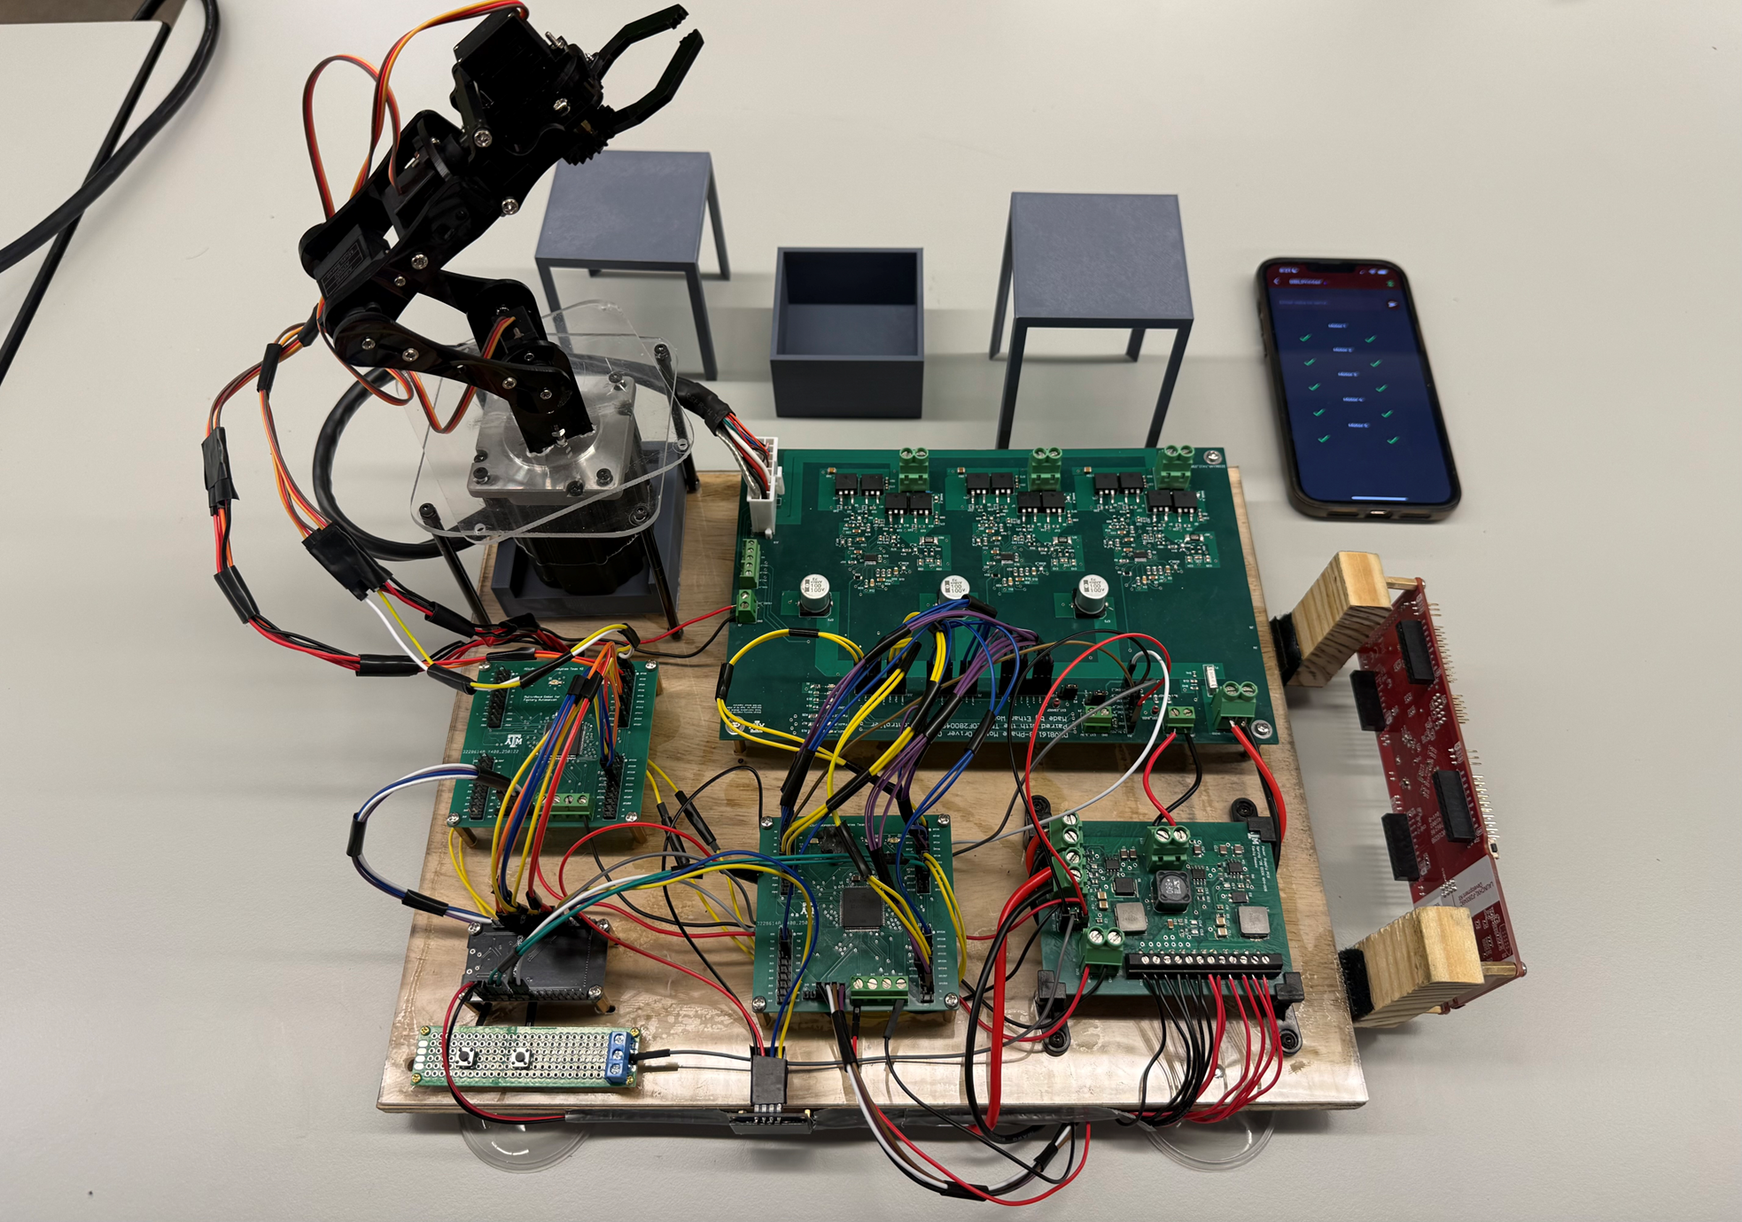
Integrated System Diagram
9. Platforms
9
Cobot Arm
1
8. Mobile App
8
2. MCU PCB 2
7. Motor Driver PCB
7
2
3. ESP32
6
3
6. Launchpad
4
4. MCU PCB 1
5
5. Power PCB

Slide 9
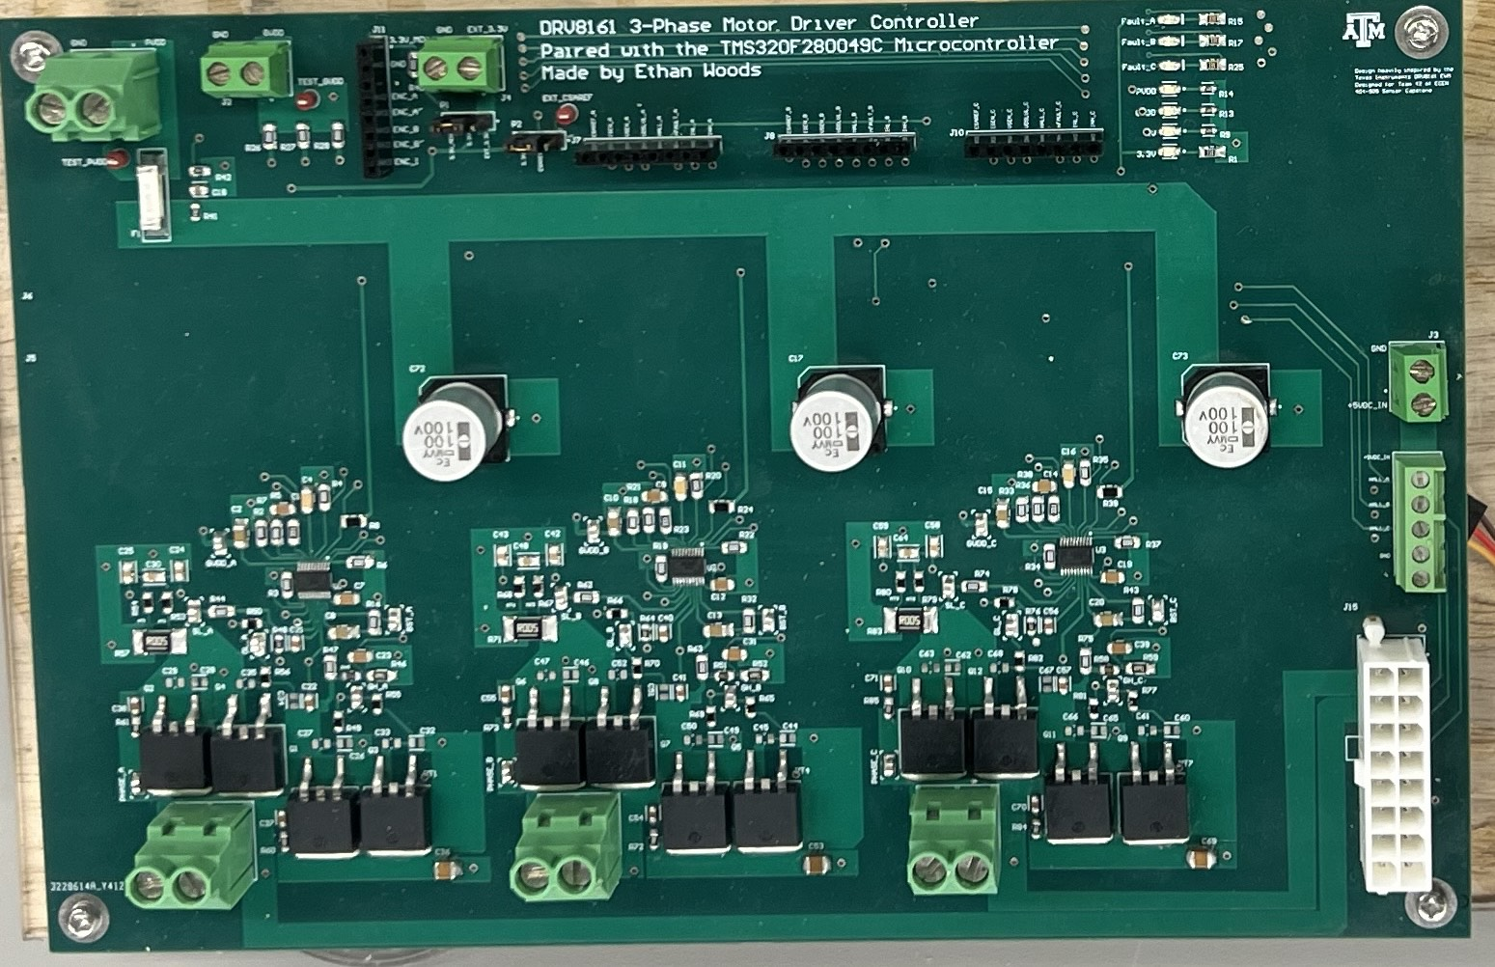
Motor Driver: Design Accomplishments
Design:
Custom 3-Phase Motor Driver PCB with DRV8161 Smart Gate Drivers
Modeled after Texas Instruments' DRV8161EVM with design changes for integration and simplicity
Internal hardware selection modes are unchangeable
DTMODE (0), IDRIVE1/2 (7), VDSLVL (0), CSAGAIN (5 V/V)
GPIO headers for direct interface with MCU-generated control signals (e.g., TMS320F280049C)
High-voltage power input terminals for motor supply (PVDD) and logic supply (GVDD/5V/3.3V)
Custom motor connector for 3-phase output, with integrated Hall sensor and Encoder feedback routing
Status and fault indication LEDs for each phase
Assisted with Code Integration for the MCU Subsystem
Code modeled after the DRV8161 EVM GUI.c
Allowed for PWM generation for Independent PWM Mode
Integrated BLDC Motor with rest of Cobot design through Pololu Universal Mounting Hub
PVDD Input
GVDD Input
3.3V Input
GPIO Headers
Feedback LEDs
5V Input
Phase A
Phase B
Phase C
Custom Motor Mount

Slide 10
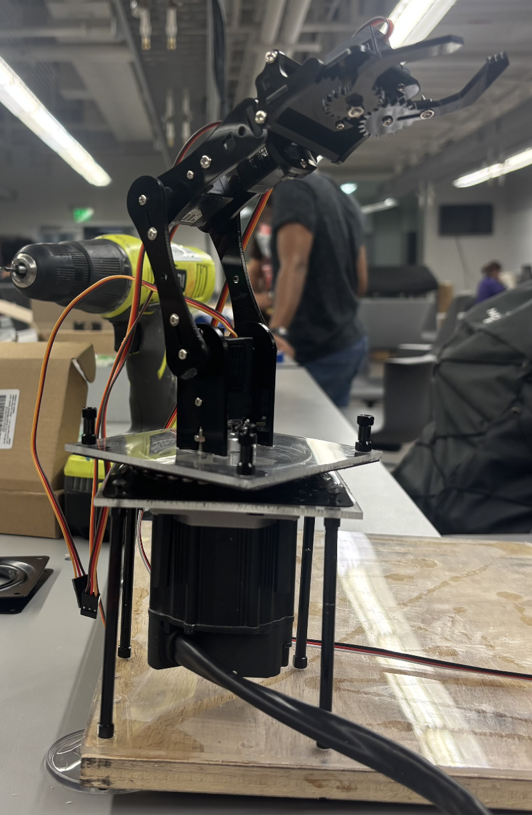
Motor Driver: Design Accomplishments
Ethan Woods
Integrated Cobot Design:
DRV8161 3-Phase Motor Driver Controller:
Design:
PCB containing 3x DRV8161 Motor Drivers to DRIVE movement for a 3-Phase BLDC Motor
Takes control signals from the MCU Subsystem to produce the 3 phases to spin the BLDC Motor
Takes power input from Power Supply Subsystem to power the PCB
Motor internal encoder allows for position and movement control
Cobot Development
Implementation of BLDC Motor into Amazon Cobot Kit
Mounted motor using Universal Mounting Hub with Acrylic Plates
Assisted with layout, wiring, and implementation of motors
Encoder Implementation
Utilize internal encoder to set rotational boundaries of arm rotation
Controls 3-Phase BLDC Motor
Inputs:
48 Volts (PVDD)
12 Volts (GVDD)
5 Volts (Encoder)
3.3V (Reference Voltage)
Phase Control Signals
7x Signals Per Phase
Outputs:
3-Phase Motor Drive Signals
Outputs high-power signals to drive a 3-phase BLDC motor
Encoder Passthrough Outputs
Access to encoder outputs through on board terminal/header

Slide 11
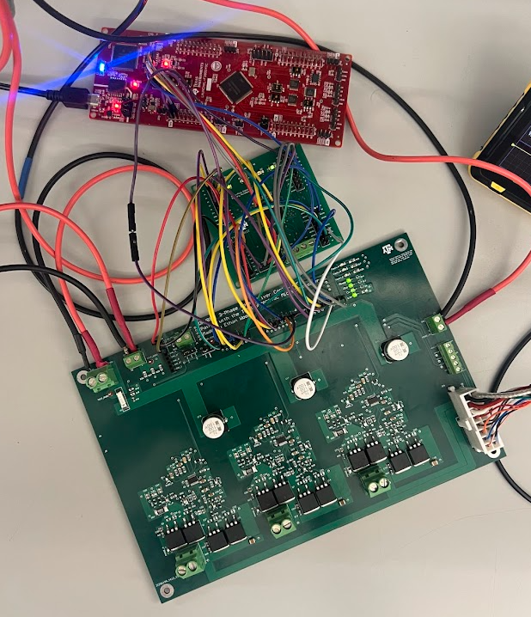
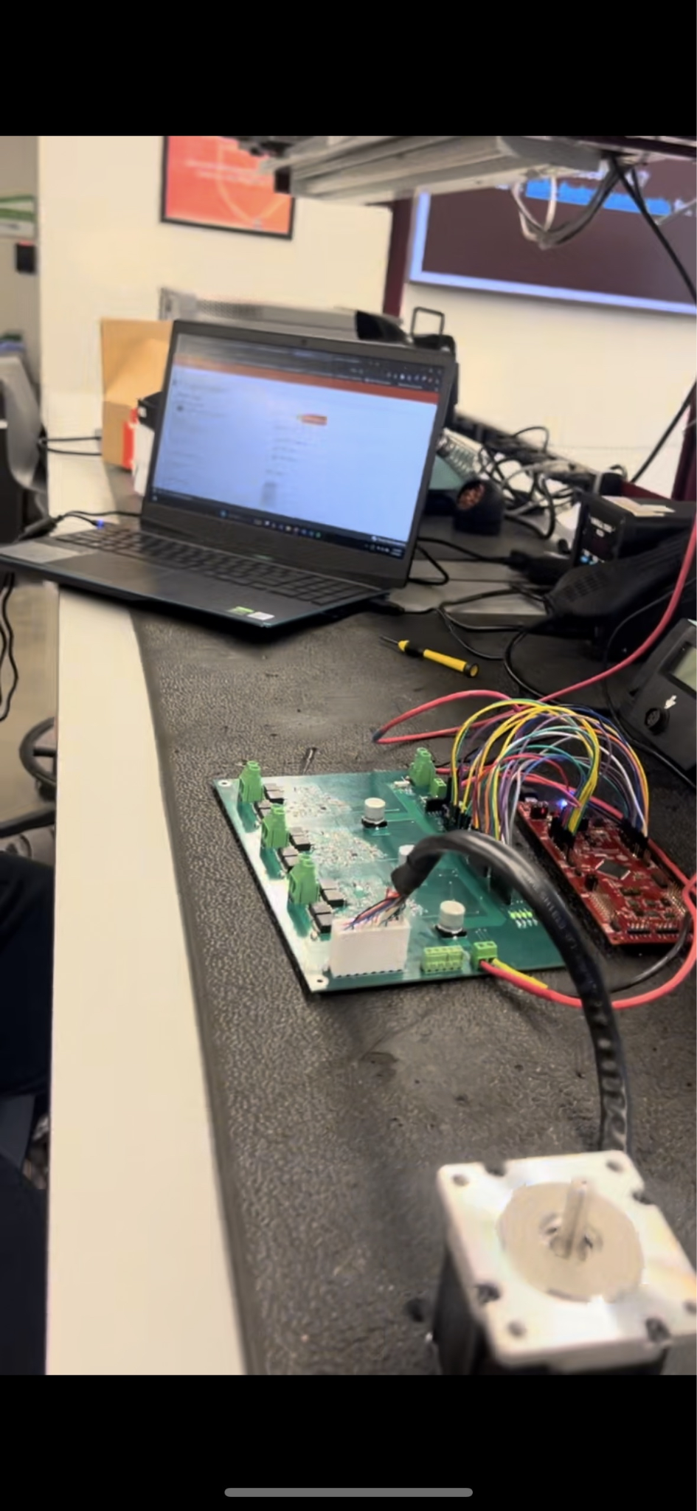
Motor Driver: Design Accomplishments
Ethan Woods
Testing Before Integration:
(Needs GUI.c and C2000 Launchpad)
Testing After Integration:
(MCU PCB Board and Launchpad (to Flash))
Tested:
3-Phase BLDC Motor Movement
Motor can spin given the correct input signals from MCU and Power
Movement (CW/CCW) first tested through DRV8161 EVM GUI.c. Once confirmed, moved to integration
Encoder Implementation
Internal encoder in 3-Phase BLDC Motor provides positional data which can be used to create rotational boundaries
Instead of moving on a degree-per-movement basis, decided on rotational boundaries
Validation:
Motor Movement - 3-Phase BLDC Motor movement through communication between MCU and Motor Driver Board
Precise Movement - Implementation of Encoder to control precise movement of motor.
Tough to control precise movement through Wireless Application, so instead defined rotational boundaries of BLDC Motor
As it is hard to individually assess my subsystem, it is validated through its use in other subsystems, by performing as desired.

Slide 12
MCU/Processing: Design Accomplishments
Adrian Guzman
Design
Created Two MCU PCBs
PCB 1 controls BLDC
PCB 2 controls Servo
Software Development
Developed firmware for BLDC and Servo control
Used TI’s example code and libraries in CCS
Cobot Implementation
Designed full motion flow and control architecture
Completed physical layout and wiring for MCU and motor interface
Tested
Code Build & Compilation
Successfully compiled and flashed firmware to C2000 MCU
TI Launchpad to debug
GPIO Signal Accuracy
Verified logic-level outputs for 4-axis servo
Validated PWM signal generation for BLDC
ESP-32 communication
Receive BLE commands from iOS app
C2000 MCU correctly drives motors
Validated
JTAG Programming of MCU
ESP-32 & C2000
Low-level signals toggle motor control GPIOs
MCU & Motor Driver
BLDC motor operates with precise control
Signal timing and logic confirmed to DRV8161
MCU & Power
Stable 3.3V input
Servo Motor
Accurate servo movement and step accuracy

Slide 13
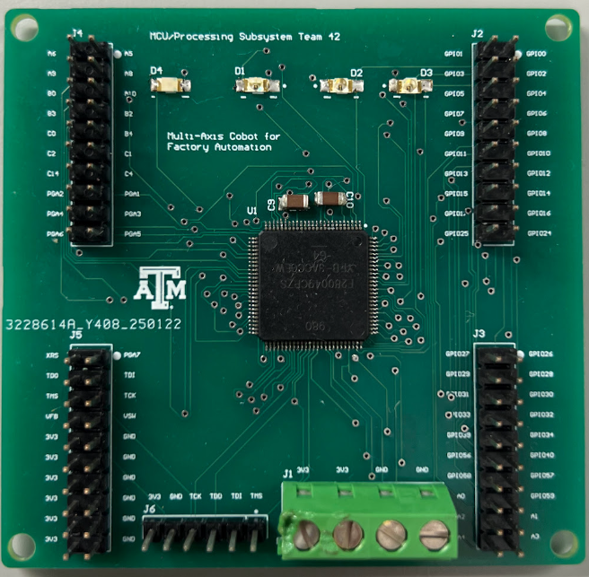
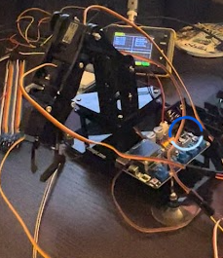
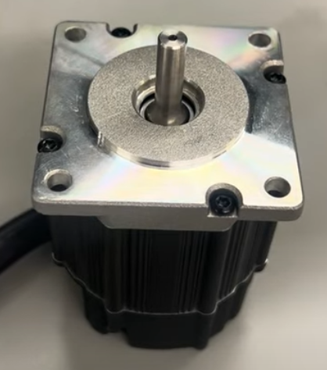
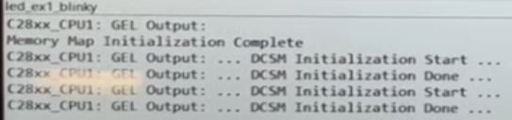
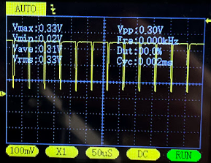
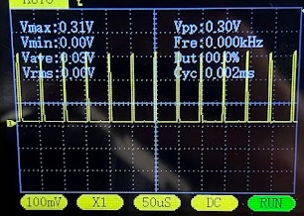
MCU/Processing: Design Accomplishments
Adrian Guzman
GPIOs
LEDs
GPIOs
Precise control of BLDC motor to add 360° of motion to base. Precision supported by low duty cycle
Accurate movement of 4x Servos creating 4-axis of rotation
GPIOs
GPIOs
TMS320F280049C
3.3V Input
JTAG
Compile and flash program onto target device. Launchpad used with onboard debug probe
High and Low PWM generation to drive 3-Phase BLDC
*Decoupling capacitors on the back

Slide 14
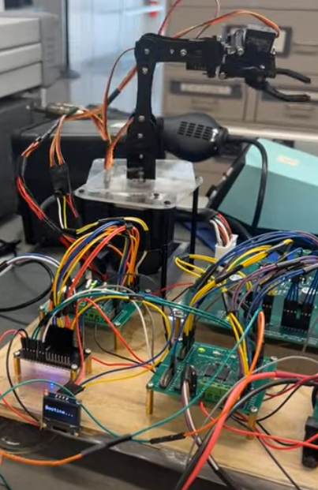
1
Integrated System:
360° BLDC movement
180° Servo movement
Pick up and move small objects
User control through app
User control through physical buttons
2
3
4
(1) Servo Motors
(3) ESP32
(2) BLDC Motor
(4) MCU PCBs

Slide 15
MCU/Processing: Design Accomplishments
Adrian Guzman
MCU Board #1 (BLDC Motor)
MCU Board #2 (Servo Motors)
Connection Mapping: (C2000 to ESP-32)
Connection Mapping: (C2000 to ESP-32)
Connection Mapping: (C2000 to Cobot Servos)
Motor | Button | C2000 GPIO | Motion
Motor 1 | Button 1 | GPIO 14 | LEFT
Motor 1 | Button 2 | GPIO 12 | RIGHT
Motor | C2000 GPIO | ESP32 GPIO | Motion
Motor 2 | GPIO 33 | GPIO 4 | UP
Motor 2 | GPIO 34 | GPIO 16 | DOWN
Motor 3 | GPIO 24 | GPIO 17 | UP
Motor 3 | GPIO 31 | GPIO 5 | DOWN
Motor 4 | GPIO 12 | GPIO 18 | LEFT
Motor 4 | GPIO 27 | GPIO 19 | RIGHT
Motor 5 | GPIO 32 | GPIO 15 | OPEN
Motor 5 | GPIO 14 | GPIO 2 | CLOSE
Motor | C2000 GPIO | Motion
Motor 2 | GPIO 0 | PWM Signal
Motor 3 | GPIO 1 | PWM Signal
Motor 4 | GPIO 6 | PWM Signal
Motor 5 | GPIO 7 | PWM Signal
Connection Mapping: (Button to C2000)
Motor | C2000 GPIO | ESP32 GPIO | Motion
Motor 1 | GPIO 15 | GPIO 13 | LEFT
Motor 1 | GPIO 16 | GPIO 12 | RIGHT

Slide 16
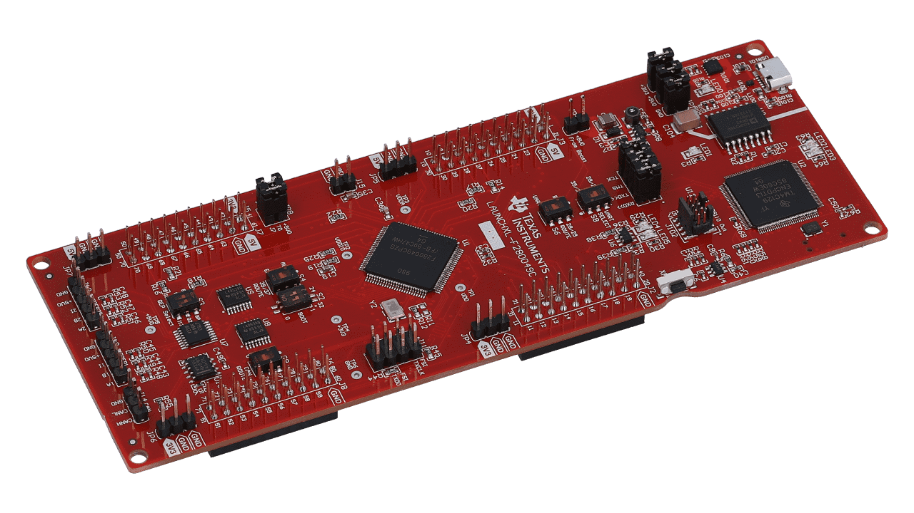
MCU/Processing: Design Accomplishments
Adrian Guzman
Challenges Encountered
Flashing Software Issues
Low Power Mode Error: CCS failed to flash MCU #1 (BLDC) when powered by 3.3V from external supply.
Resolved by powering via LaunchPad.
Flash Memory Limitation: MCU #1 (BLDC) lost program on power-off.
Required re-flashing at each boot
No issue on MCU #2 (Servo), which retains memory.
C2000 Ware Development Hurdles
Example Projects: Helpful initially, but editing caused frequent errors–especially between Driverlib and Bitfield styles of programming.
Learned differences in includes, function syntax, and structure
Include Paths: Frequent errors/warnings even when paths were correctly added in CCS.
Wrote BLDC code in led_blinky, Servo code in empty_driverlib to take advantage of existing includes

Slide 17
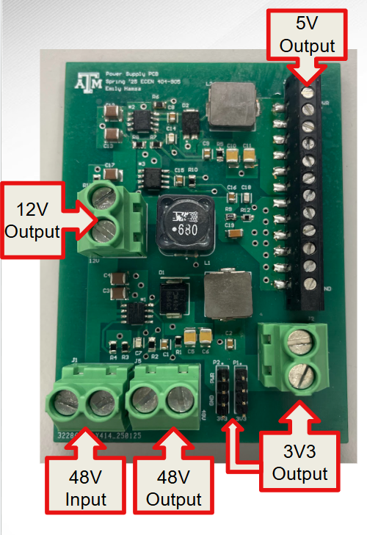
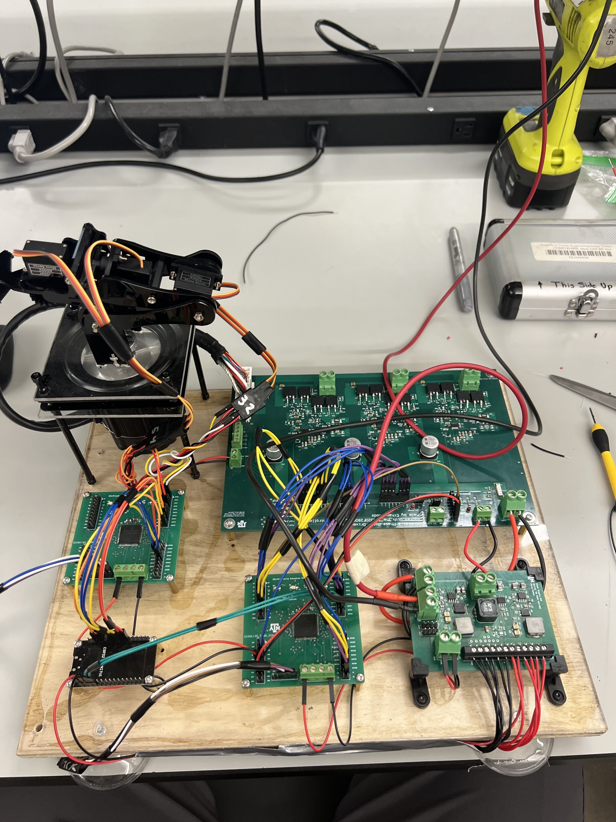
Power Supply Subsystem: Design Accomplishments
Emily Hamsa
Design Requirements
Input | 48V
Output | From compiled load list: 48V, 4A 12V, 50mA 5V, 1A 3V3, 300A
Power Source | Battery
Final Design
Input | 48V, 10Ah Battery
Output | 48V, 1A 12V, 1A: LM5164DDAR 5V, 3.5A: LM5013DDAR 3V3, 2.5A: LM5012DDAR
Connections | 48V, 1A: BLDC Motor 12V, 1A: Motor Drivers 5V, 3.5A: Servo Motors x5 ESP32 Motor Encoder 3V3, 2.5A: MCU Motor Reference

Slide 18
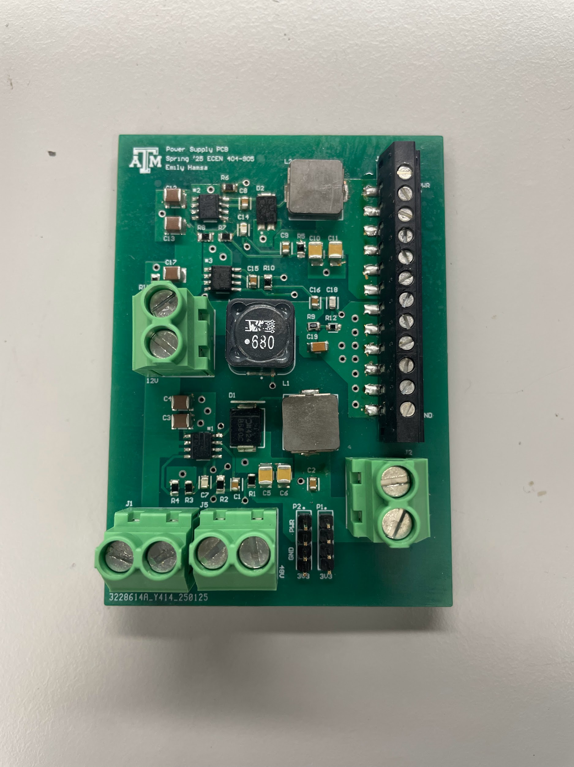
Power Supply Subsystem: Design Accomplishments
Emily Hamsa
Design
PCB designed to take in 48V input and step down this voltage through TI buck converters, which is then delivered to the rest of the system. The outputs of this board are as follows:
48V, 1A:
BLDC Motor PVDD
12V, 1A: LM5164DDAR
Motor Drivers GVDD
5V, 3.5A: LM5013DDAR
Servo Motors x5
ESP32
Motor Encoder
3V3, 2.5A: LM5012DDAR
MCU
Motor Reference
The design process included:
TI WEBENCH to create the schematics
Load-list creation using datasheets and expected power draw from each component in the system to choose adequate TI buck converter chips
The use of signal layers and polygon pours for less power flow congestion
5V
Output
12V
Output
3V3 Output
Power Supply PCB
48V Input
48V Output
Protection Considerations
In-line 5A fuse between the battery and Cobot to protect against overcurrent faults and shorts
Implementation of a switch and input capacitor at the input to allow for quick disconnect of battery power and in-rush current (*In progress)

Slide 19
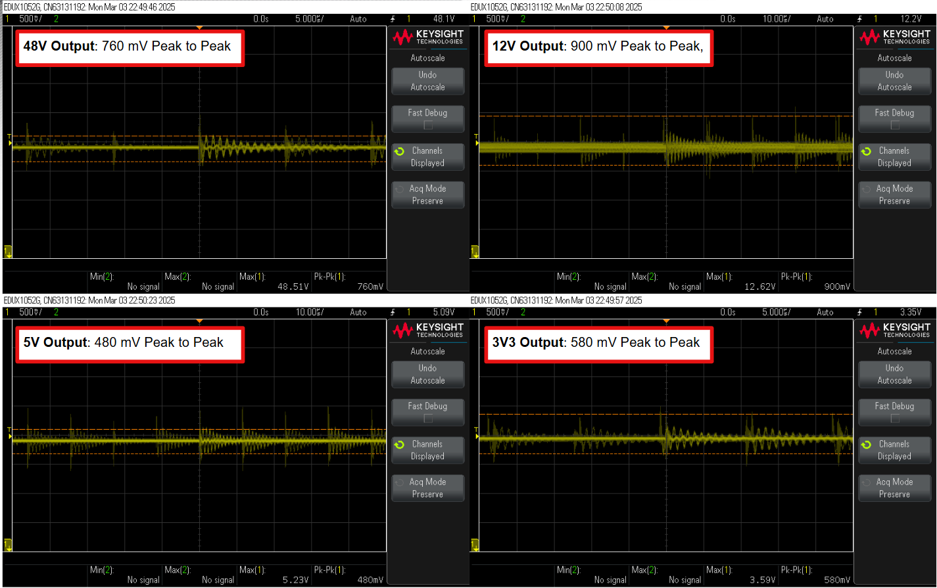
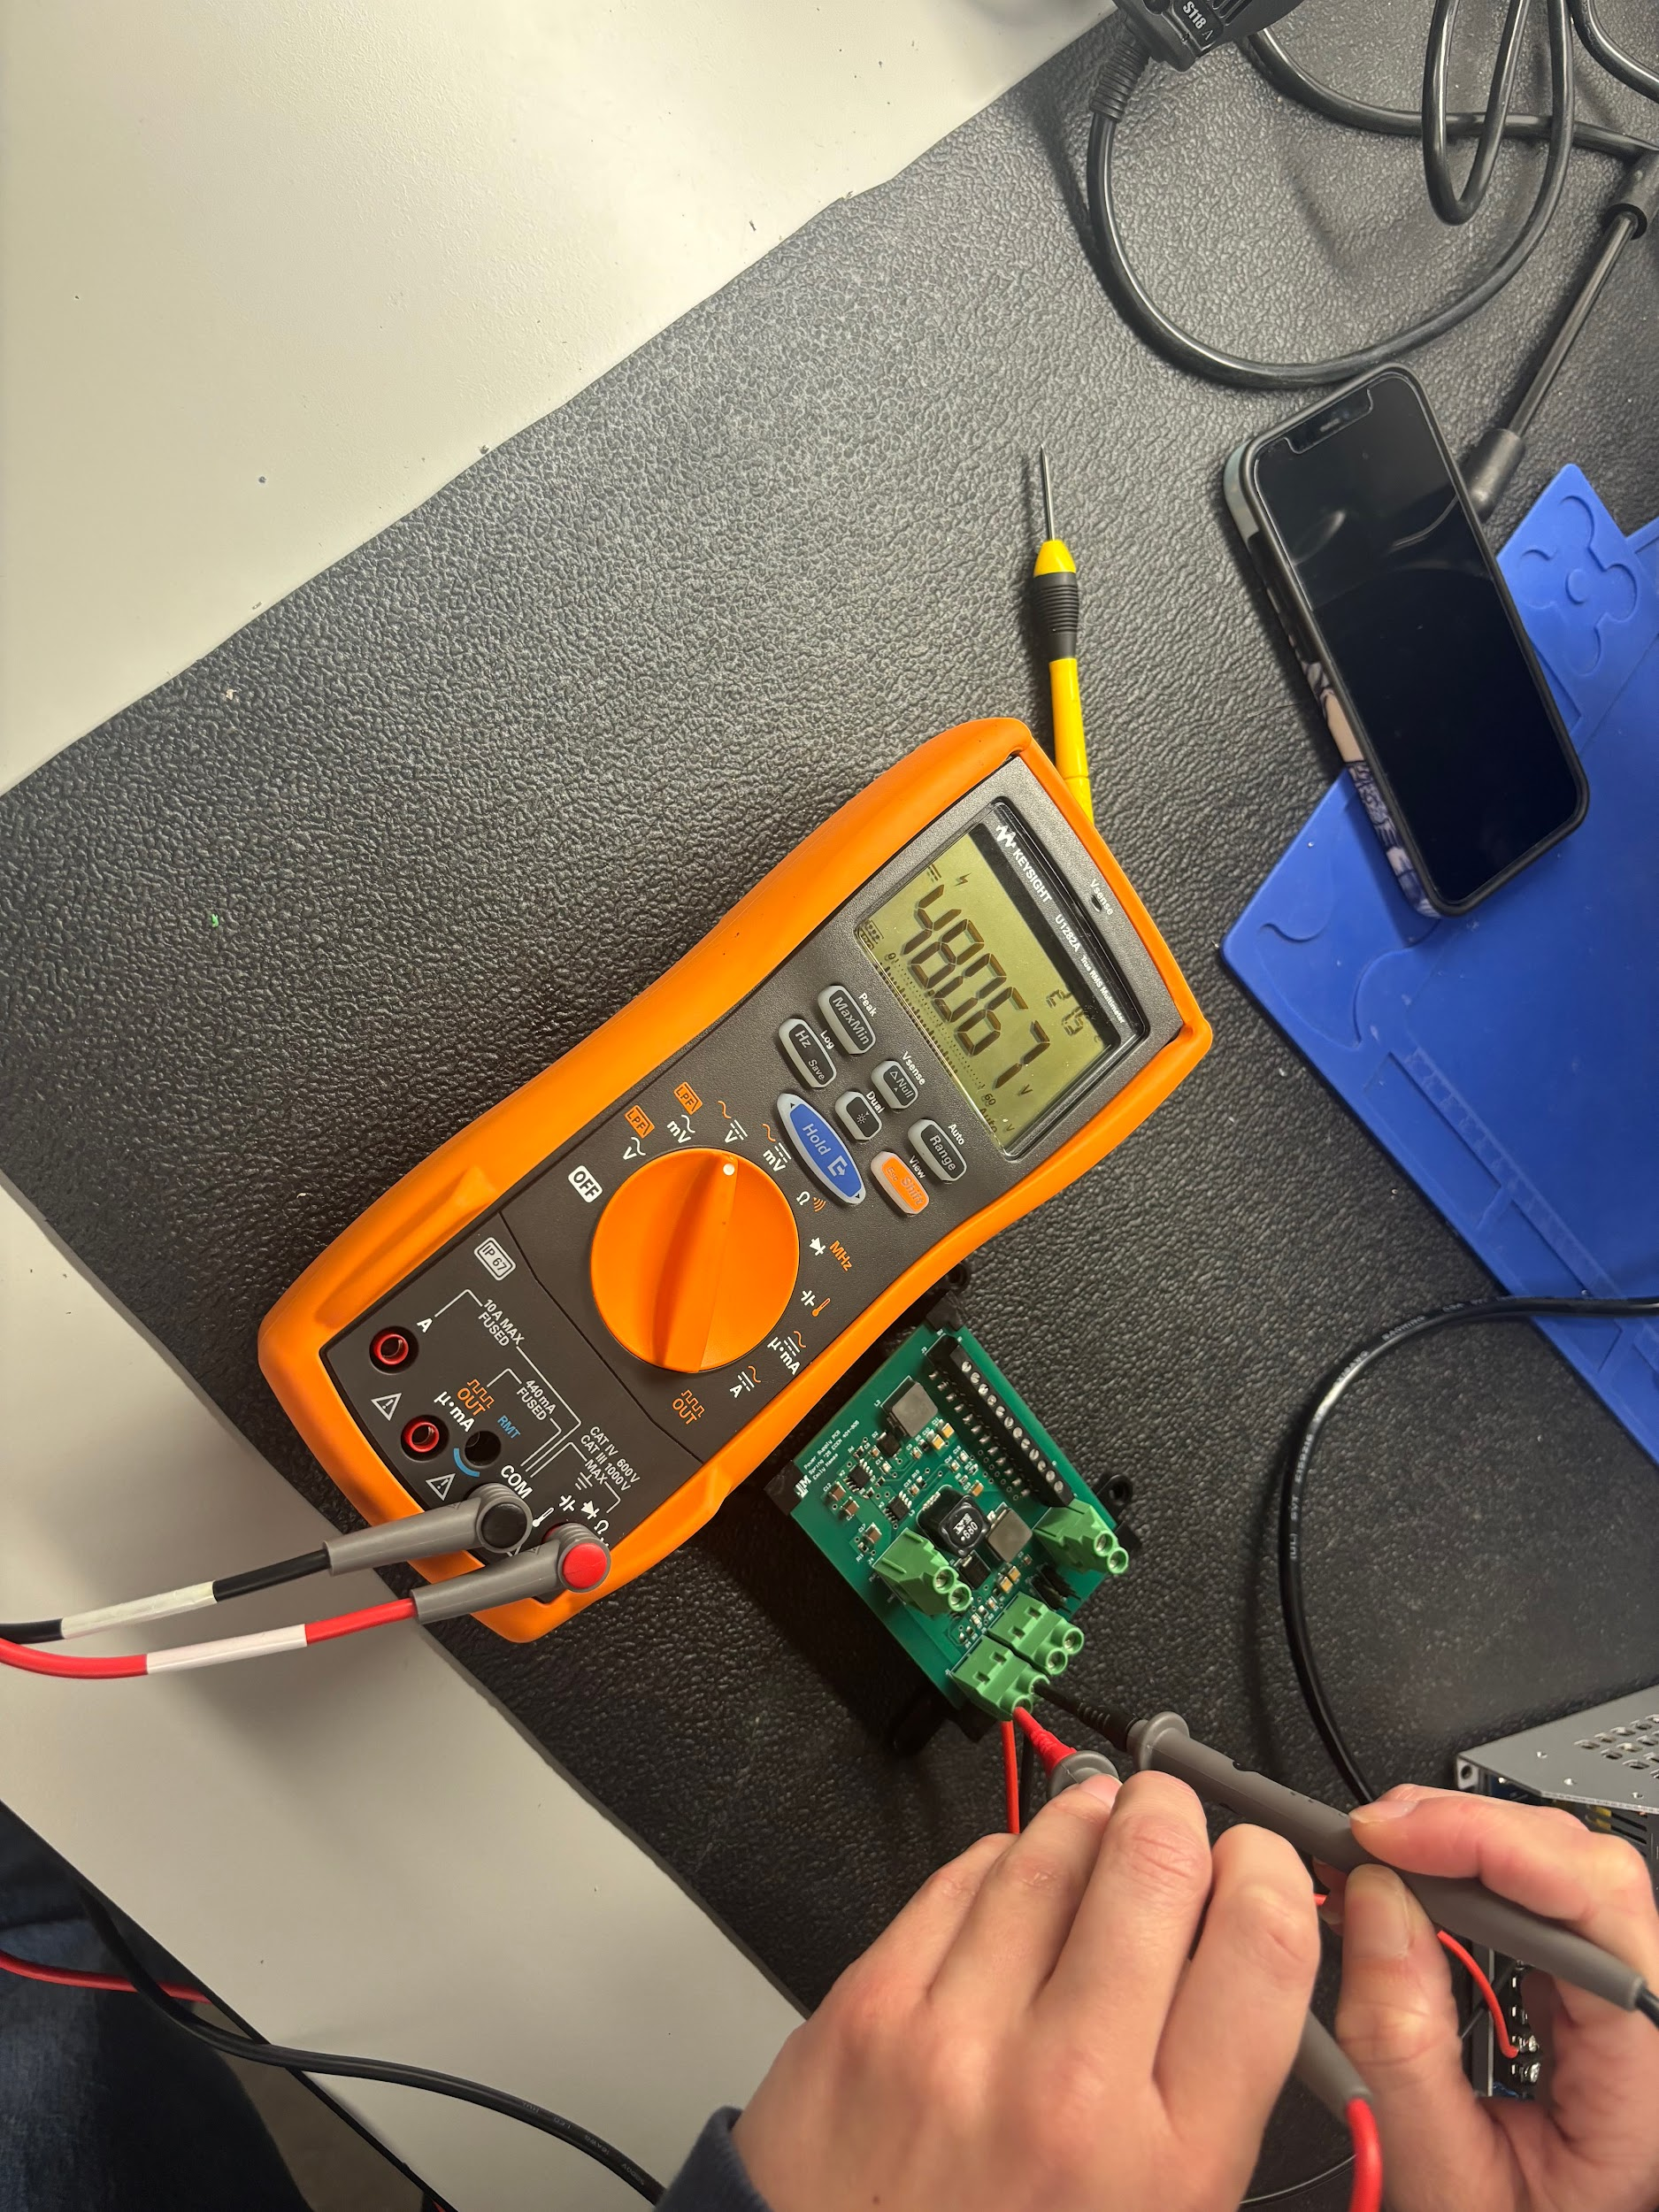
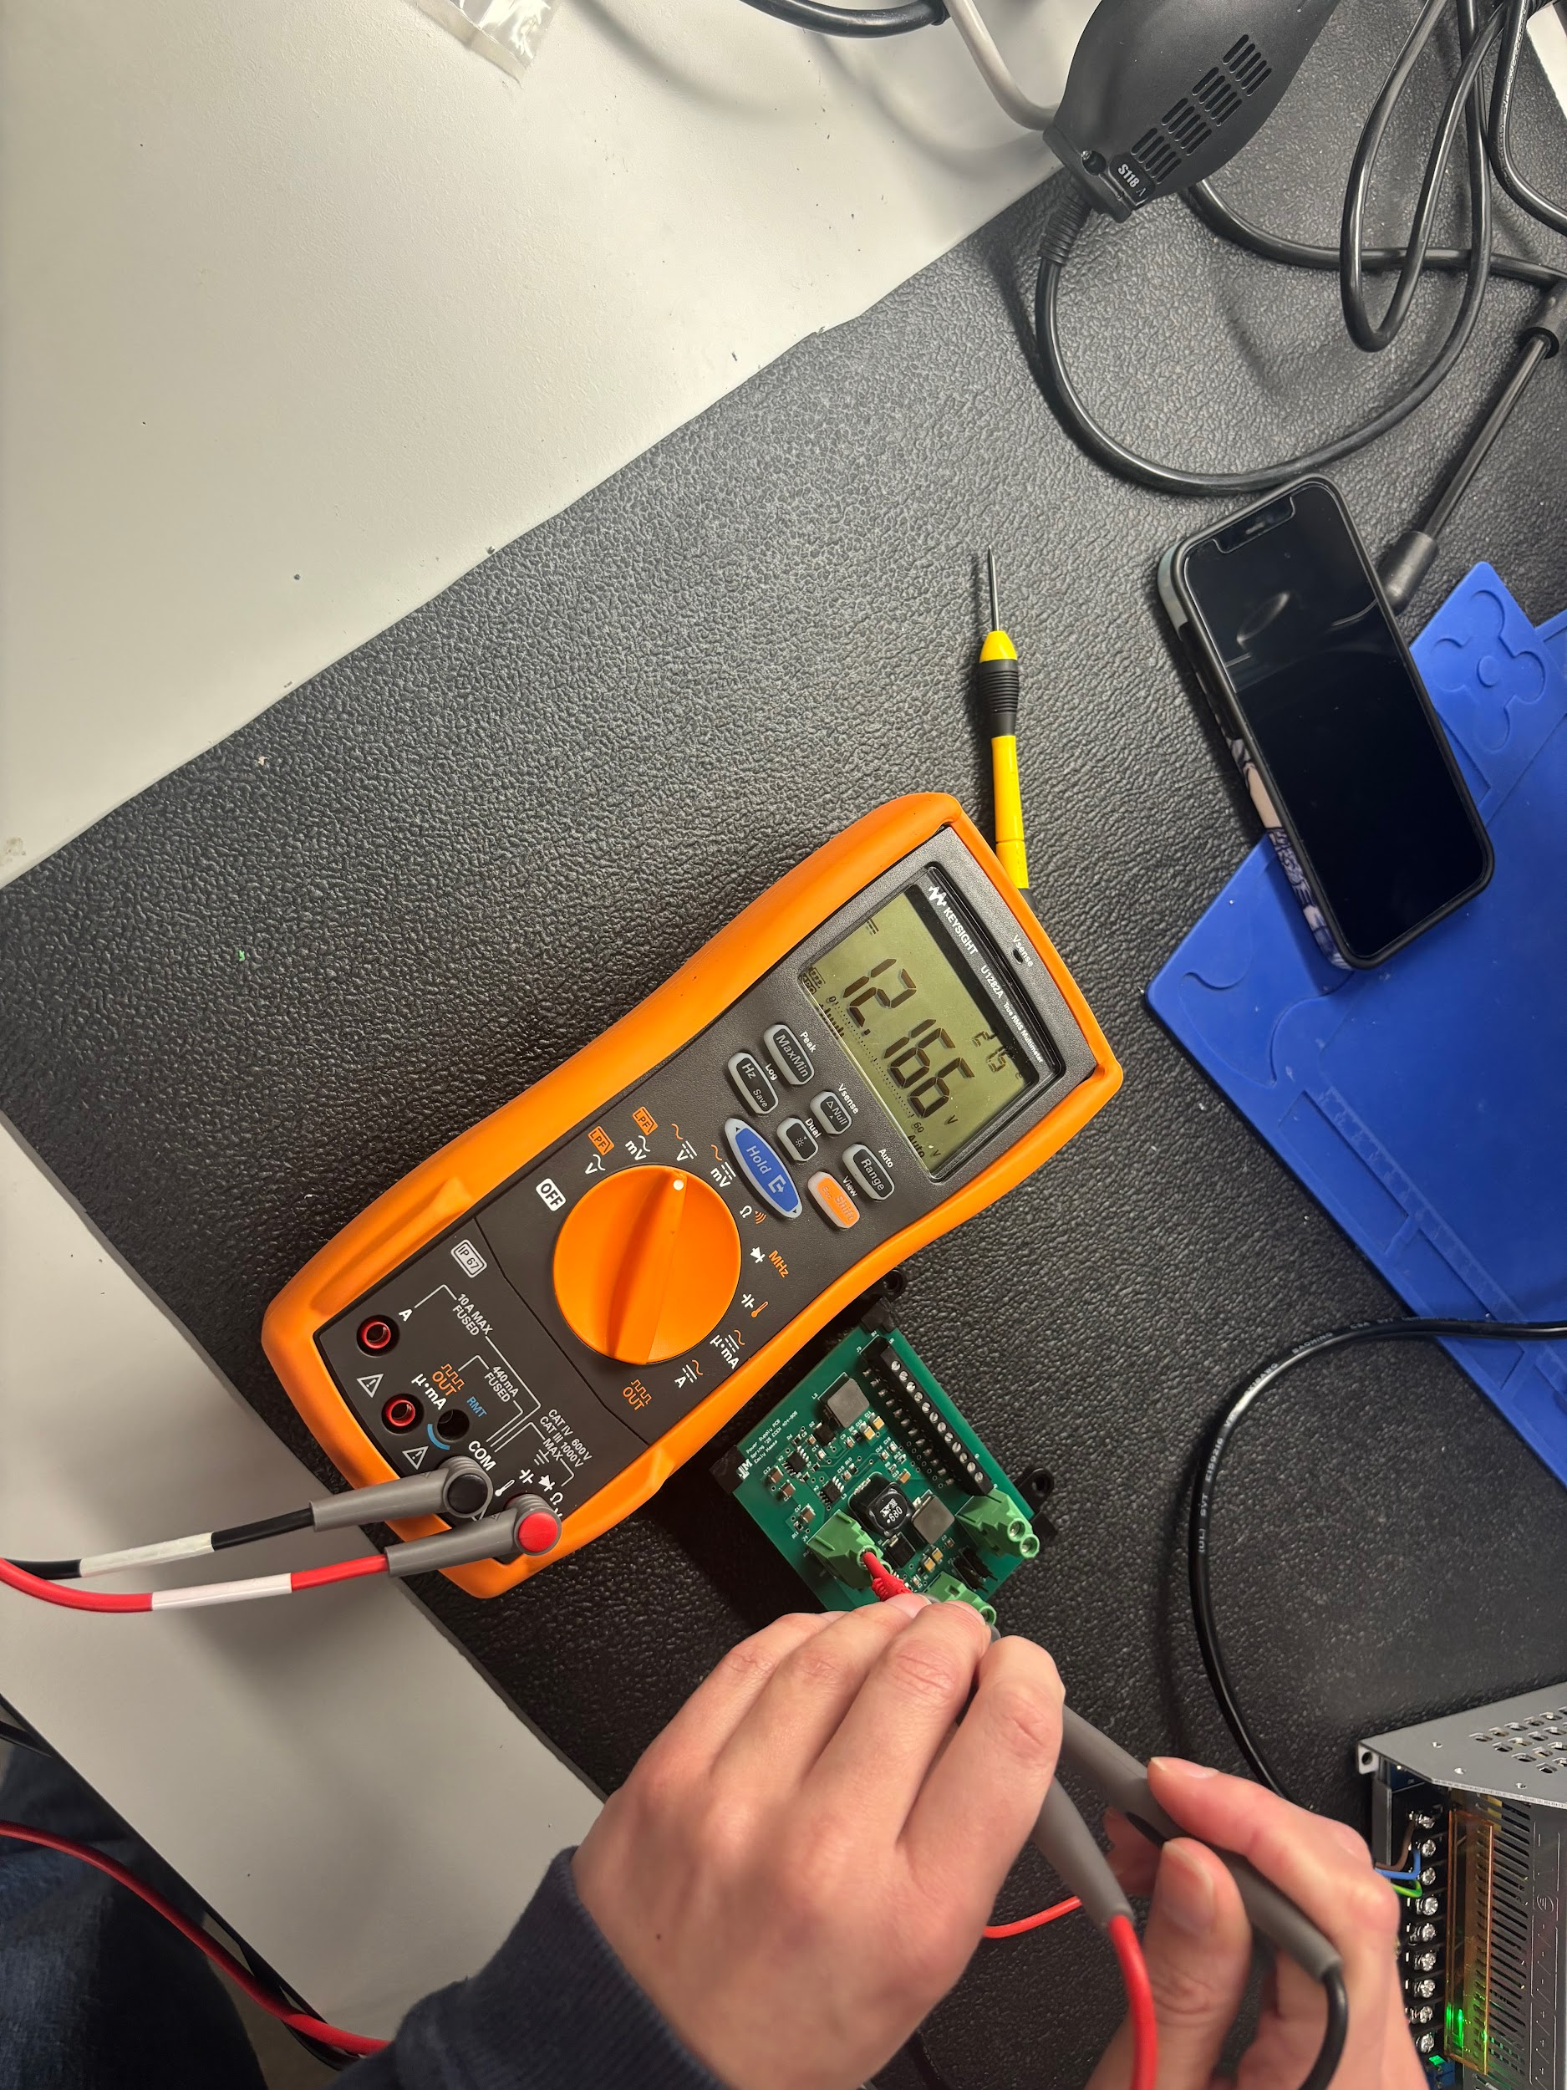
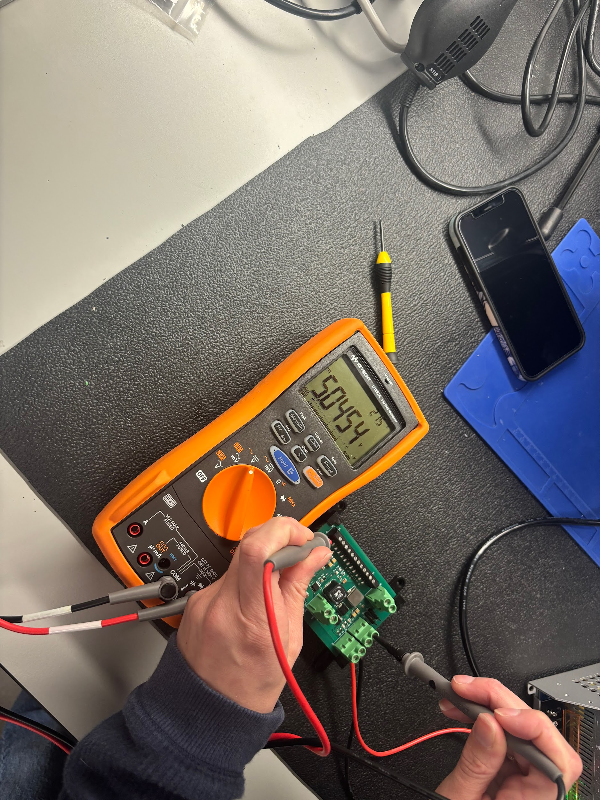
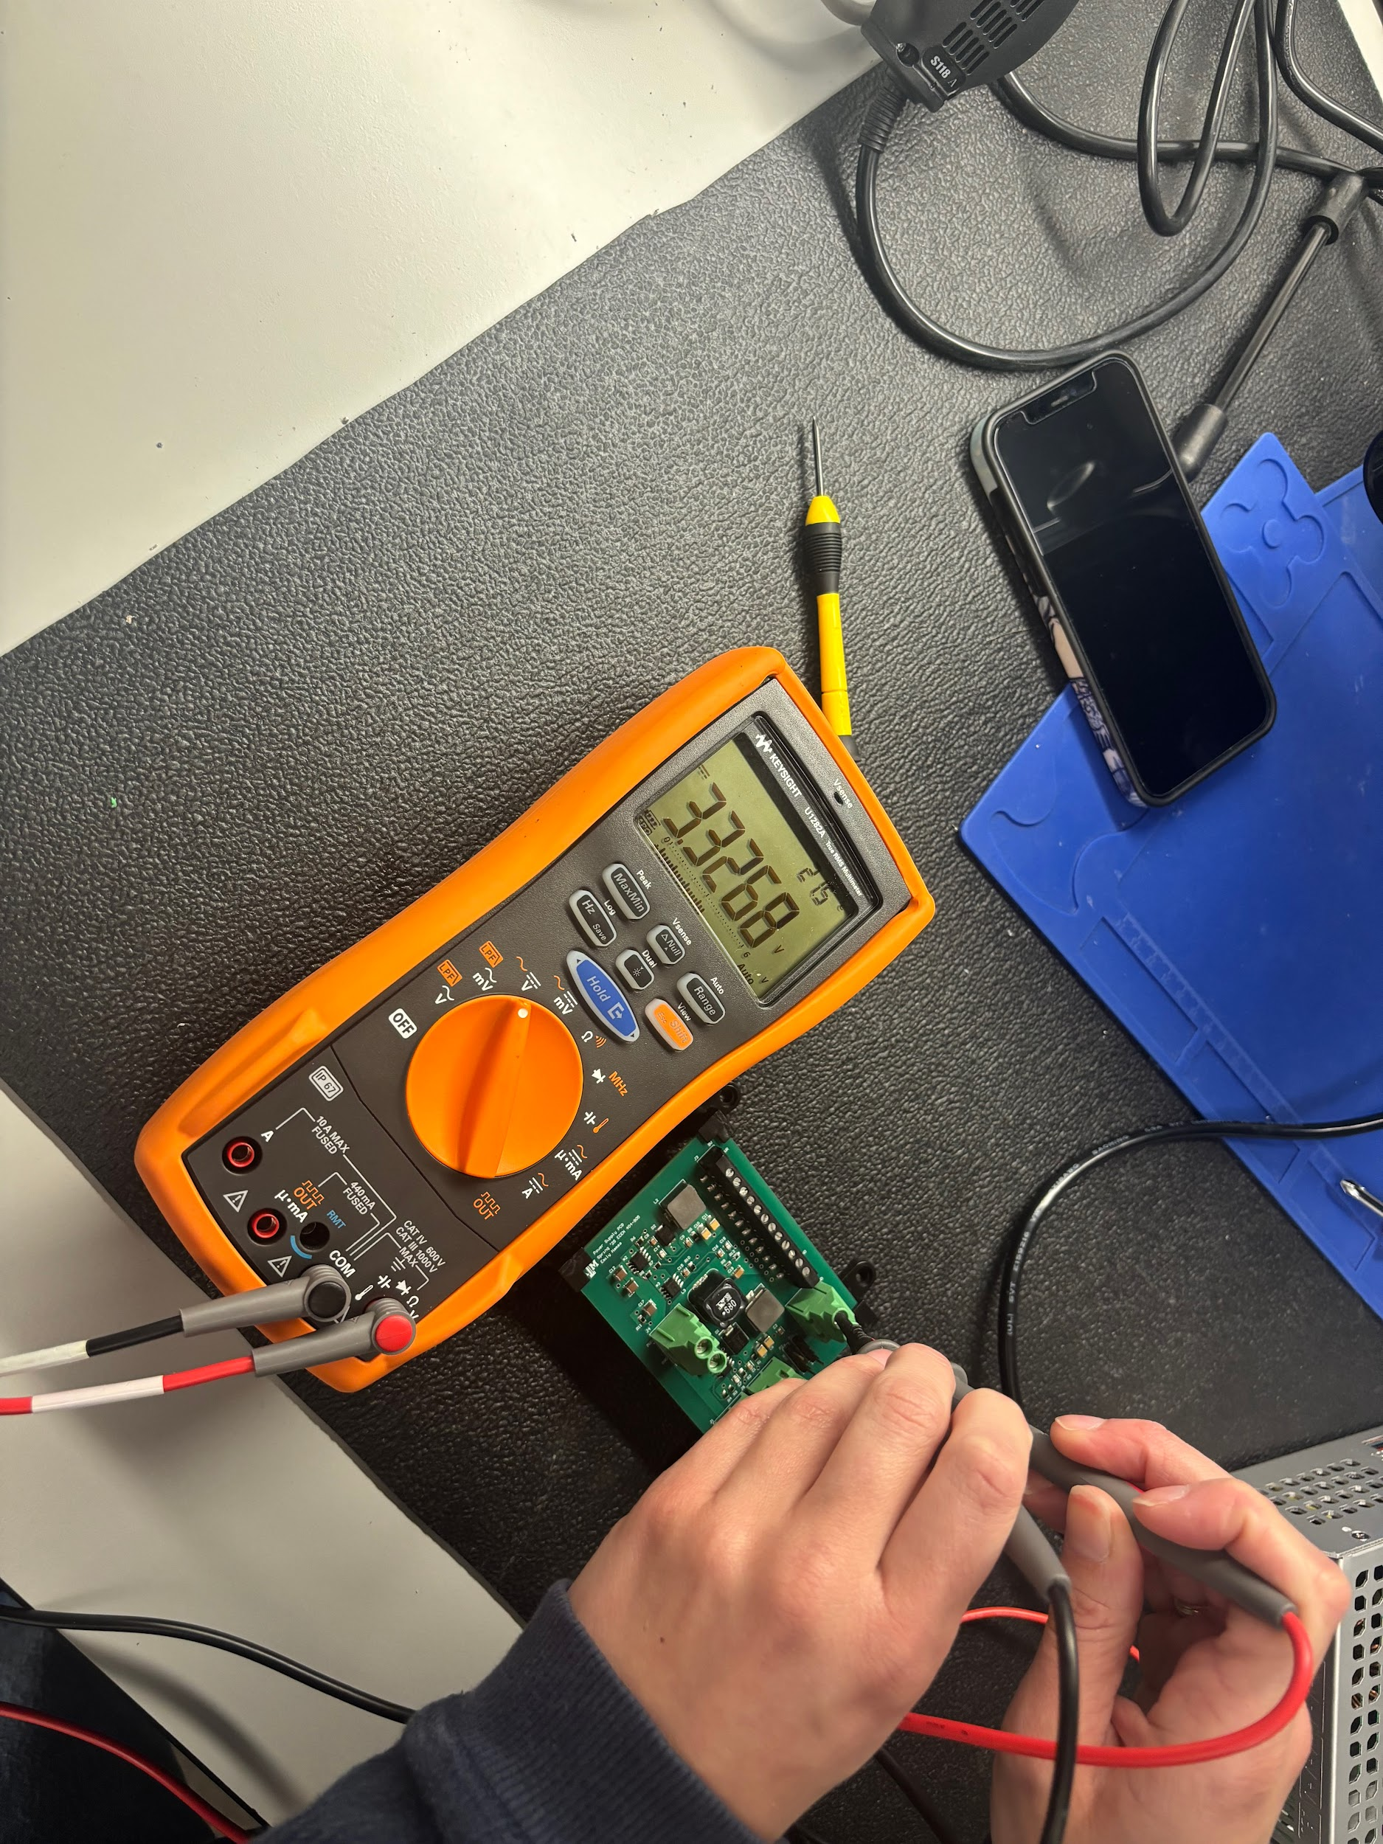
Power Supply Subsystem: Design Accomplishments
Validation: No Load
Emily Hamsa
Minimal Noise: DC Signal
Voltage Step-Down

Slide 20
Power Supply Subsystem: Design Accomplishments
Emily Hamsa
Tested
Capability of step-down circuitry
PCB is able to take input and output the intended voltages successfully
Voltage noise at output
Some noise is present but did not cause additional issues during testing
Load Handling
Using an E-Load, tested that the PCB can continue to deliver the correct voltages even when experiencing maximum intended loading
Battery Testing
Using an E-Load, tested that the battery can deliver constant voltage when power demands increase suddenly
Full System Integration Testing
Ensured PCB could supply power to Cobot when functioning as intended
Tested cobot can be fully operational with a battery as the power source (*In progress)
Noise at output terminals
Output Voltages

Slide 21
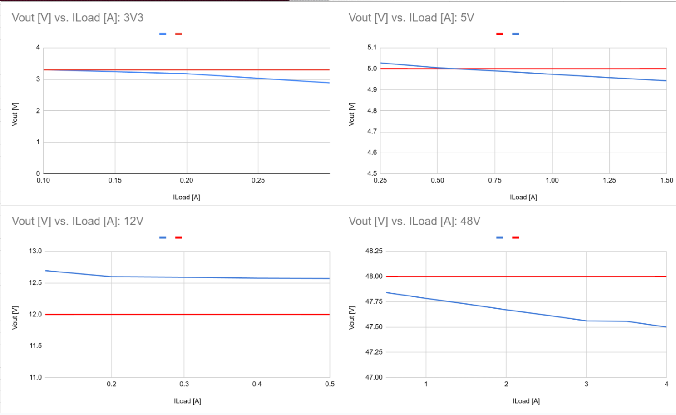
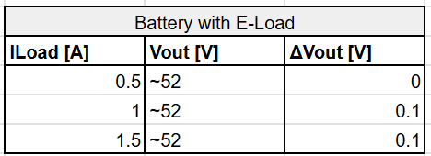
Power Supply Subsystem: Design Accomplishments
Validation: With Load
Emily Hamsa
Voltage Drop with Load
Battery Voltage Drop

Slide 22
Power Supply Subsystem: Design Accomplishments
Emily Hamsa
Validation
PCB is outputting correct output voltages as expected
3.2.3.1.3: Voltage Step-Down
Noise at output is within reason and not causing issues throughout the system
3.2.3.2.5: Output DC Voltage
PCB can continue to supply reliable output voltage when current load is present
3.2.3.2.7: Handling Load
Battery is capable of supplying a constant output when current demands quickly change
3.2.3.1.1: Input Voltage
Full System Integration and Functionality
When using bench power supply, the Cobot works as intended, and the power PCB is able to supply reliable power to all components
With battery as power supply, inrush current is causing our fuse to blow. To fix this, a capacitor will be added from power to ground to absorb any current spiking. (This is still in progress and to be validated soon.)
Output Voltage vs Current Load: Voltage Drop
Key
Actual Voltage Output
Expected Voltage Output

Slide 23
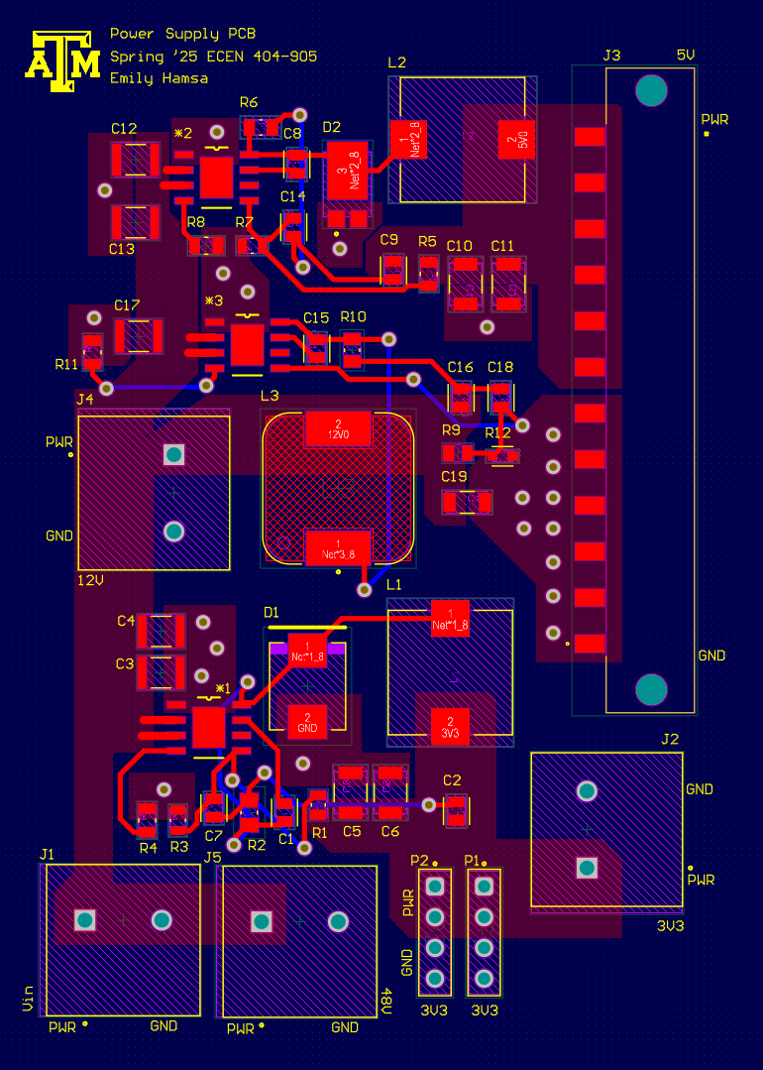
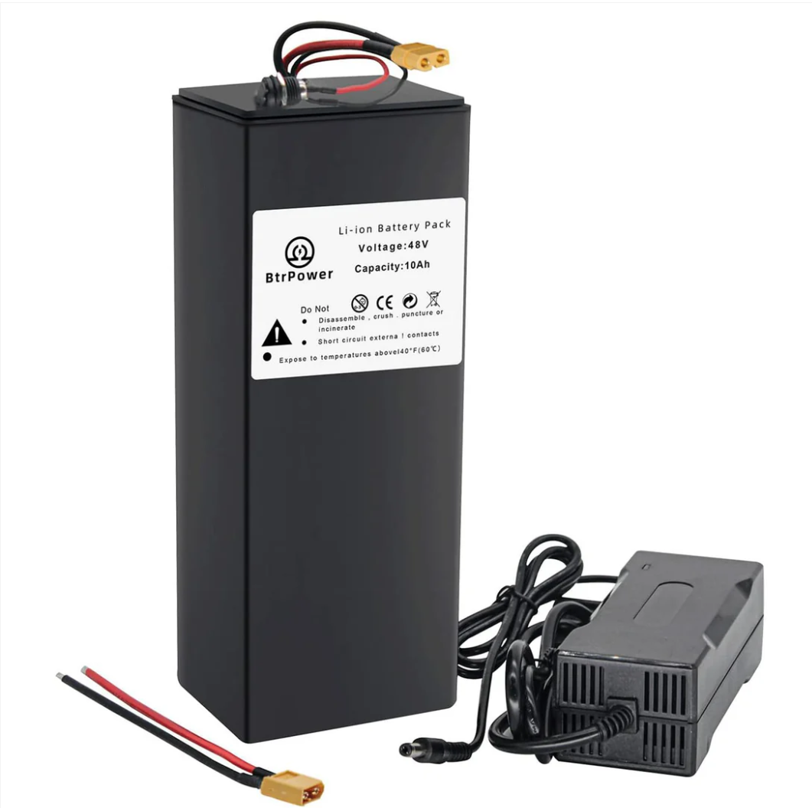
Power Supply Subsystem: Design Accomplishments
Emily Hamsa
Challenges Encountered
Board layout
Challenge: From 403, the board design was not adequate to handle the application of high voltage and current, which led to issues.
Solution: Using polygon pours and signal layers, the PCB had more success with the intended application
Shorting Signals
Challenge: When testing during integration, certain tests, such as flashing the MCU or powering the board on and off quickly, would cause the power supply PCB to enter an undefined state and send the chips into protection mode, presenting as a short.
Solution: We found that the power supply must be connected to the power supply PCB first, and then the launch pad is able to be connected and flash the MCU. We also found that the circuit needs a few moments to drain excess current before turning the power supply back on.
Inrush Current
Challenge: Inrush current from the battery is causing the fuse to blow and prohibiting our Cobot from working.
Solution: Adding a switch and capacitor from power to ground to absorb current spiking should solve this issue.
Schematic including polygon pours
Battery used in Cobot

Slide 24
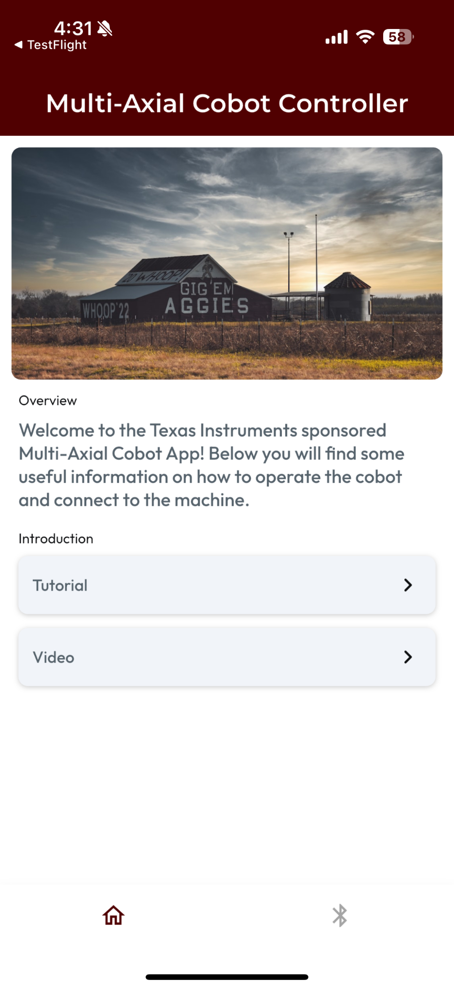
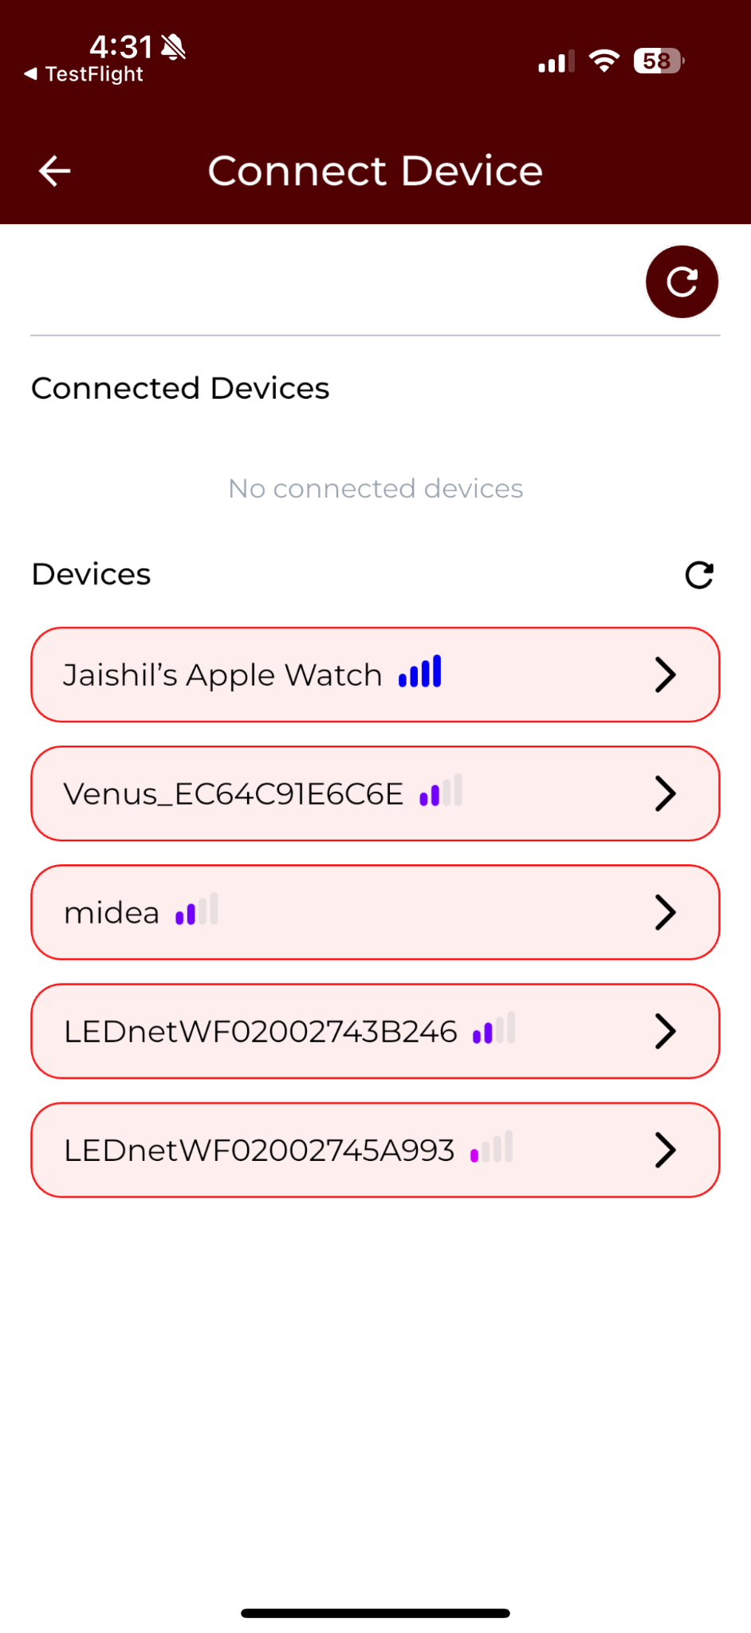
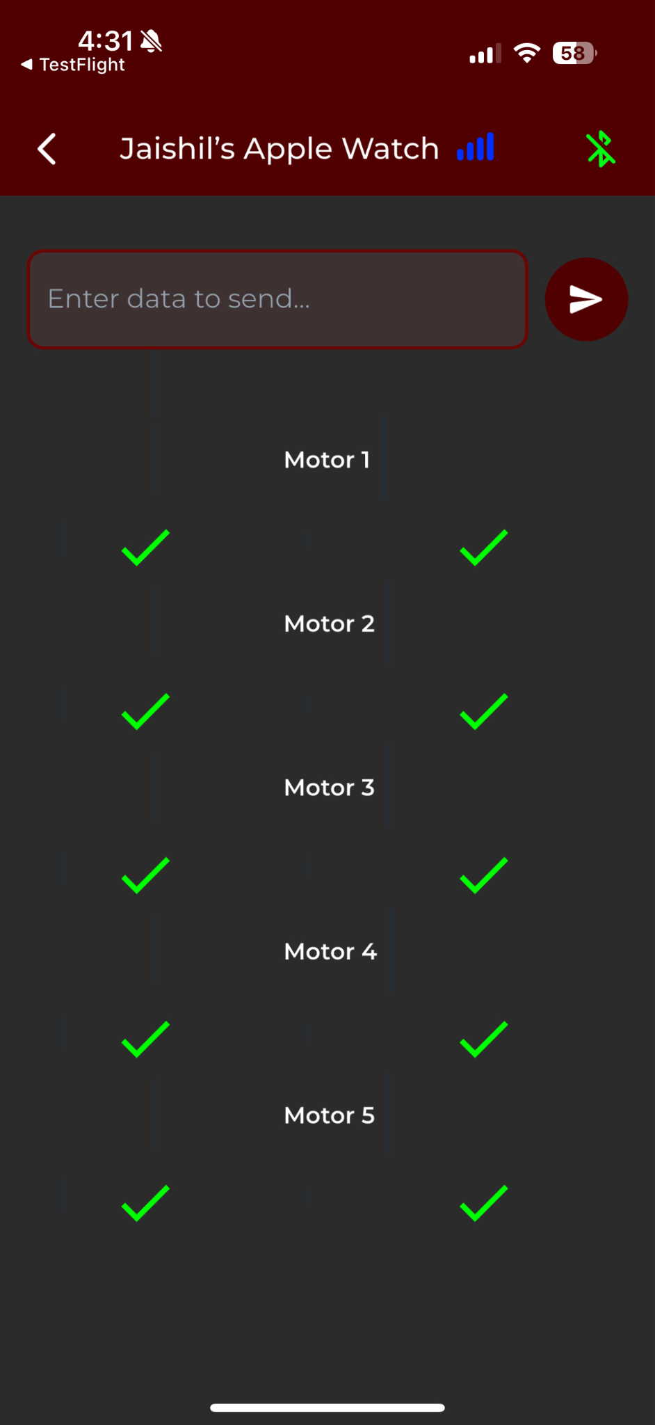
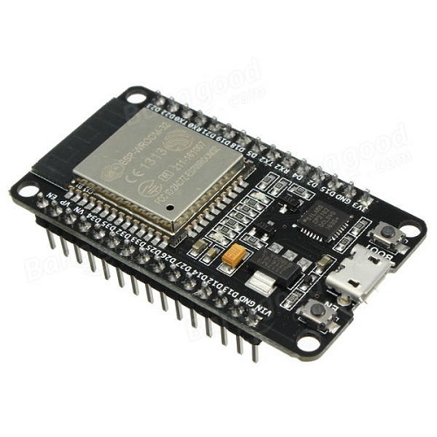
Wireless Communication & User Interface Subsystem Design Accomplishments
Jaishil Shah
Design: Software:
FlutterFlow, Arduino IDE
Mobile Application:
iOS compatible (iPad/iPhone)
Connected via Bluetooth (ESP-32)
Wireless Connectivity:
IOS --> ESP-32 --> C2000 MCU
*reverse functionality as well
List of Bluetooth Functions:
1. connectDevice 2. disconnectDevice
3. findDevices 4. getConnectedDevices
5. getRssi 6. isBluetoothEnabled
7. receiveData 8. sendData
Important Tools:
1. flutter_blue_plus 1.33.4
2. Bluetooth Low Energy
3. Arduino IDE 2.1.0
Cobot and Subsystems

Slide 25
Wireless Communication & User Interface Subsystem Design Accomplishments
Jaishil Shah
Tested:
BLDC motor movement via mobile app input
4x Servo Motor movement via mobile app input
Stable connection (app to ESP32) for 2-5 minutes
Inputs return intended Outputs
Multiple devices can access and use the app
OLED screen displays correct information and does not delay
Cobot picking up/placing down objects with claw
ESP32 functionality without laptop connection
Wireless Connectivity | Mobile app connection and communication between two devices via RX TX | Mobile app connection does not drop out more than 1 time in 5 minutes, and connects within 30 seconds. ESP-32 can communicate to external devices.
GUI Operational | User Interface (application) is deployed to mobile device | Connection is stable, input lag is minimal, and outputs are properly received/translated
Application Device Deployment | More than one device can connect & Available to all iOS devices | The application is deployed onto the device & easily accessible to multiple users
Button Functionality | Button Input Functionality | Human interaction is received and works without fault
Validated:
Successful BLDC motor movement with proper encoder functionality & precise control
Confirmed Servo motors work correctly, in the right direction, and are able to precisely execute movement
App connection does not falter and was able to withstand lengthy testing without resetting
All outputs are met with their corresponding inputs
Numerous iPhones & an iPad were able to connect and control the cobot using the app
OLED screen displays correct information and shows the current cobot movement direction
Object has successfully been picked up, moved, and relocated to final destination
ESP-32 works without re-flash & retains onboard memory.

Slide 26
Wireless Communication & User Interface Subsystem Design Accomplishments
Jaishil Shah
Wireless validation with other components:
ESP-32 → MCU (BLDC) → BLDC Motor → Motor Driver PCB (Encoder) → ESP-32 → OLED Screen
ESP-32 → MCU (Servo) → Servo Motors
Power → ESP-32
Mobile App → ESP-32

Slide 27
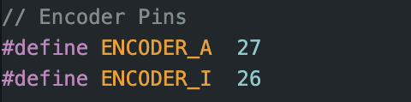
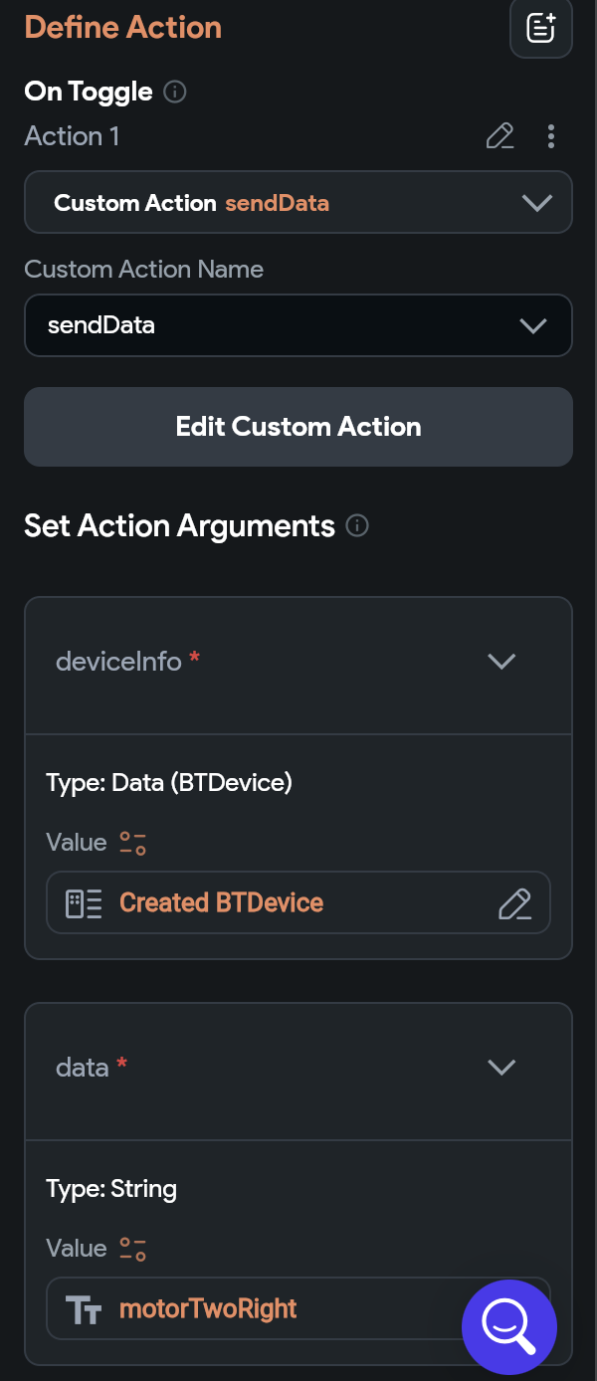
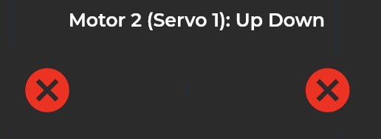
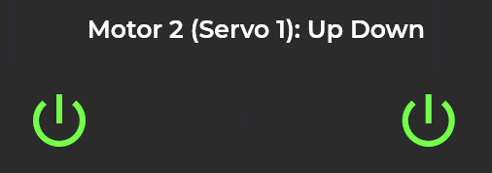
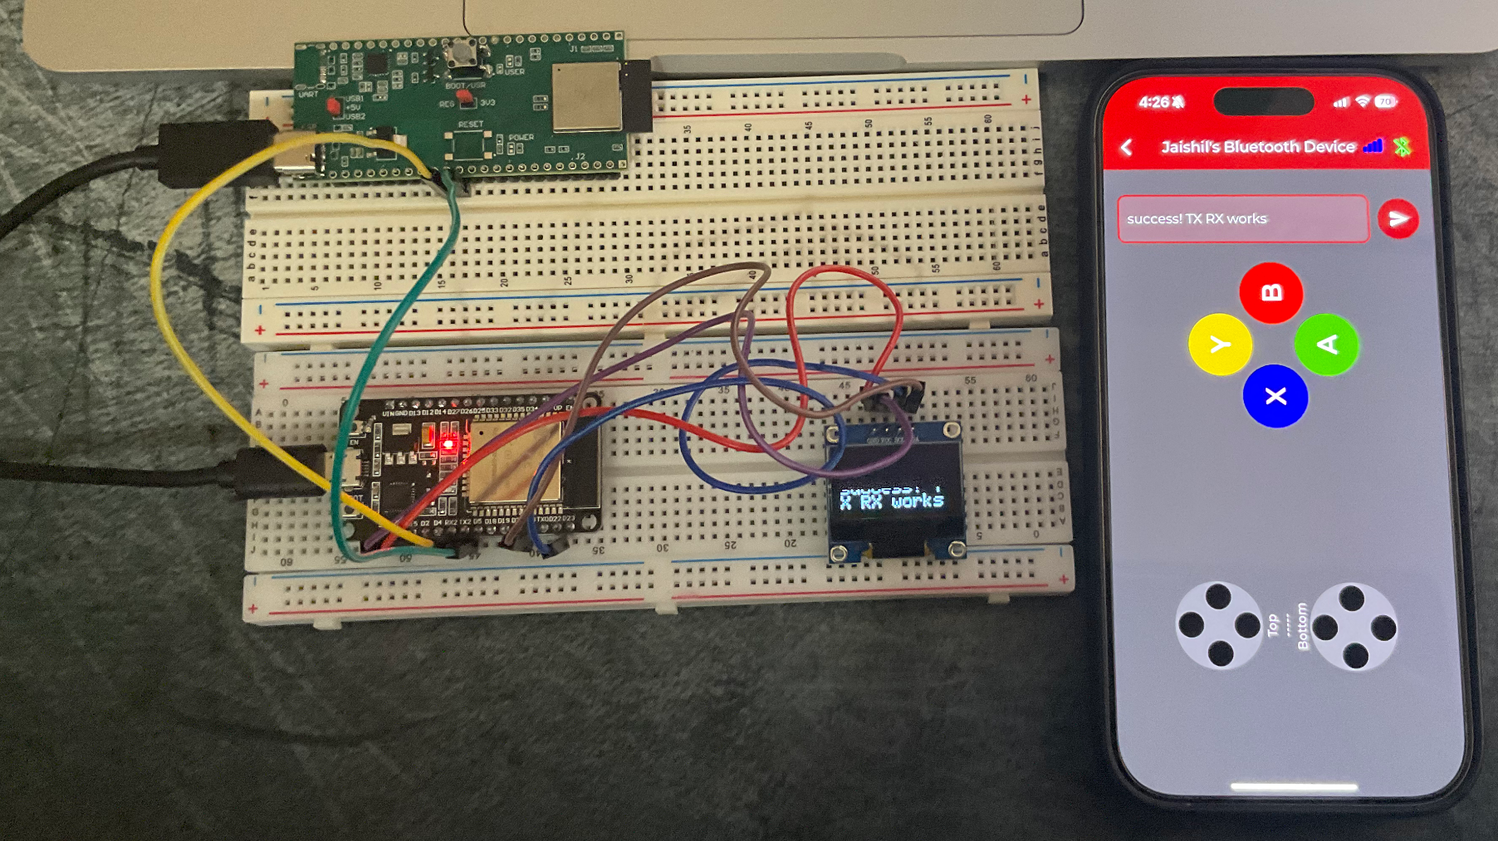
Wireless Communication & User Interface Subsystem Design Accomplishments
Jaishil Shah
Challenges Encountered:
ESP-32 Limitations: - Unable to test movement limits & motor control without outside help
Solution: Use encoder on Motor Driver Board to display “Left or Right Limit” on OLED screen
Hold and Release Button Crashes ESP-32: - Initial Design consisted of buttons that would send a signal when button is being pressed and when it is released, however caused system & ESP-32 to crash.
Solution: Using toggle buttons that keep the signal low until pressed once again.
403 ESP-32 PCB Faulty Components: -USB-C was incompatible, worked very infrequently
- Board could not hold a Bluetooth Signal for more than 5 seconds
Solution: Using a pre-built ESP-32 as the PCB design was outside the project scope.

Slide 28
Integrated System Results
End-to-End Validation
Full physical system was created, which can support all boards and cobot structurally, meeting criteria:
3.2.2.3: Structure Integrity: All components and joints are structurally sound
3.2.2.1: Mounting: When system is lifting the maximum payload, it stays mounted to its surface without tipping.
Cobot is able to function wholly and precisely, meeting criteria:
3.2.2.2: System Precision: Physical movement and load capacity functionality is able to move objects precisely and accurately.
3.2.1.1: C2000 EVM Wakeup: Launch EVM and connection is successful
Use Case Scenarios and Specs
Time to connect to application via ESP32: 10 Seconds
Ability to lift small objects, such as an eraser and small wooden block, has been validated.
Scenarios to Validate in the Future
Lifting small object, such as small Lego, and placing it in a box, further proving and validating precision.
Lift 1 pound object to validate the full range of the weight limit.
Full system test with battery as power supply.

Slide 29
Conclusions
This project required several changes from the original design to fit with budget constraints, all approved by our sponsors and professors. Despite scope adjustments, we successfully developed a wirelessly controlled conceptual cobot featuring BLDC motor integration.
Integration Issues
Minor issues were encountered during integration. System would pull max current. Problem was resolved by requiring power supply to be turned on before external hardware is connected.
Validation and Testing
The system was tested and validated according to the execution and validation plan
Changes to Scope
Cobot should lift up to 1 lbs, down from original 15 lbs - 45 lbs
Moved away from 4-5 BLDC Motors to 1
Separating BLDC and Servo software into two different MCUs
Robotic frame purchased from Amazon to allow more focus on hardware and software design
System Deliverables Met
Wireless Control - cobot movement through mobile application supported by bluetooth. Additional physical buttons added for increased control of BLDC.
Lift Load - cobot arm is able to lift and move 1lb object to different locations
Battery Powered - operational through a 52V 10Ah external battery
Small Design - compact design allows cobot to be placed in small environments

Slide 30
Conclusions
This project required several changes from the original design to fit with budget constraints, all approved by our sponsors and professors. Despite scope adjustments, we successfully developed a wirelessly controlled conceptual cobot featuring BLDC motor integration.
Integration Issues
System initially drew max current during integration
Resolved by powering the supply before connecting external hardware (launchpad)
Validation & Testing
System tested and validated per our execution and validation plan
Scope Changes
Reduced payload from 15-45 lbs to 1 lb
Replaced 4-5 BLDC motors with 1 BLDC + 4 Servos
Split BLDC and servo control across two MCUs
Used pre-built frame to focus on hardware/software design
System Deliverables Met
Wireless Control: Mobile app + physical buttons for full cobot control
Lift Capacity: Can move up to 1 lb object accurately
Battery Powered: Runs on 52V 10Ah external battery
Compact Design: Fits into tight environments

Slide 31
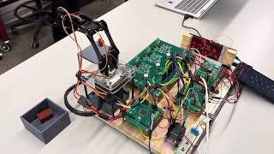
Video
Link: https://www.youtube.com/watch?v=QByI_CSOyoY

